Slide 1
Pattern Recognition for Customer Behavior Analysis:
A Study Using the UCI Online Retail II Dataset
Reporter: YUNG-CHUN LAN

Slide 2
Intro
Data Cleaning
Standardization & PCA
Unsupervised Learning Method
Supervised
Learning Method
Conclusion
Motivation
To understand how customers behave based on their past purchases.
To see how well classical PR methods can help us find different customer.
Overview
1. Data cleaning, aggregation, visualization
2. Data standardization, dimensionality reduction (PCA)
3. Unsupervised learning method (K-means)
4. Supervised learning method (compare LDA, KNN and Naïve Gaussian)

Slide 3
Intro
Data Cleaning
Standardization & PCA
Unsupervised Learning Method
Supervised
Learning Method
Conclusion
Raw Data: 541,910 rows, 8 columns
After Data Cleaning: 397,925 rows, 8 columns
Invoice | Invoice number (those starting with “C” indicate returns)
StockCode | Product code
Description | Product description
Quantity | Quantity purchased
InvoiceDate | Transaction date and time
Price | Unit price
CustomerID | Customer identifier
Country | Customer’s country
Invoice | Stockcode | Description | Quantity | InvoiceDate | Price | Customer ID | Country
536365 | 85123A | WHITE HANGING HEART T-LIGHT HOLDER | 6 | 2010-12-01 08:26:00 | 2.55 | 17850 | United Kingdom

Slide 4
Intro
Data Cleaning
Standardization & PCA
Unsupervised Learning Method
Supervised
Learning Method
Conclusion
Aggregation on Customer ID (4339 rows, 8 columns)
Feature | Description | Effect
Recency | Number of days since the last purchase | Customer activity level
Frequency | Number of purchases | High-frequency vs. low-frequency customer
Monetary | Total spending | Measuring customer value
AvgUnitPrice | Average unit price | Assessing spending level
UniqueItems | Number of product types purchased | Identifying diverse vs. specialized customer groups
AvgQuantPerOrder | Average quantity per order | Assessing bulk vs. non-bulk purchasing behavior

Slide 5
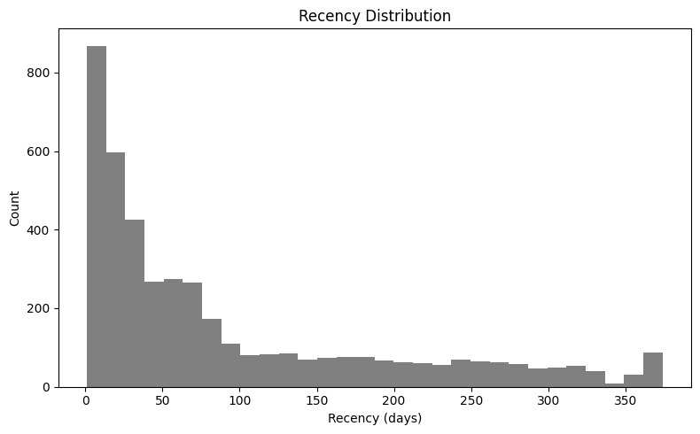
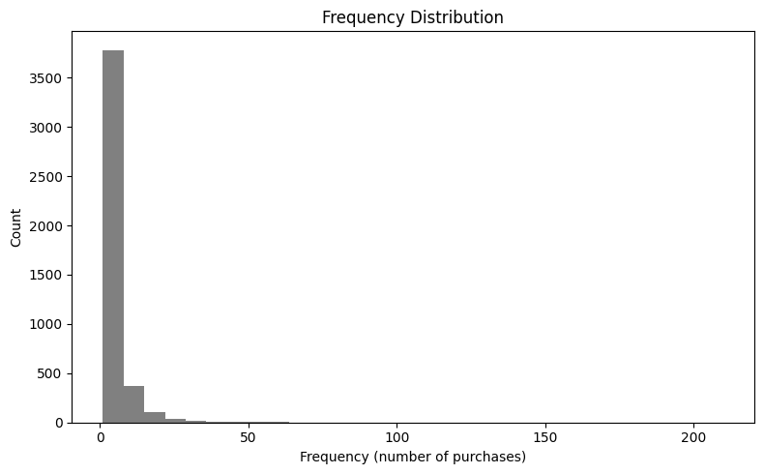
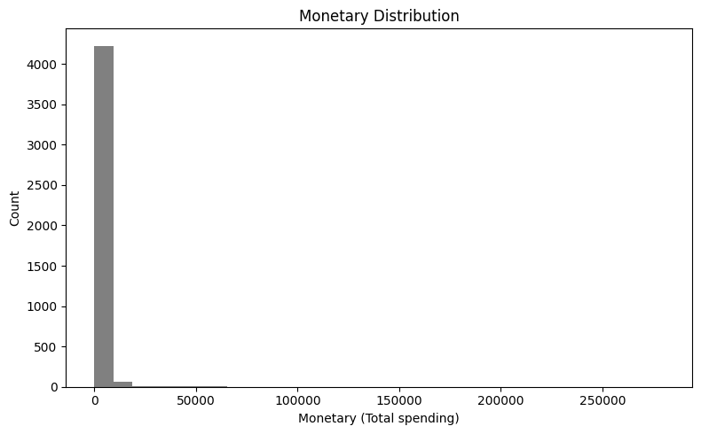
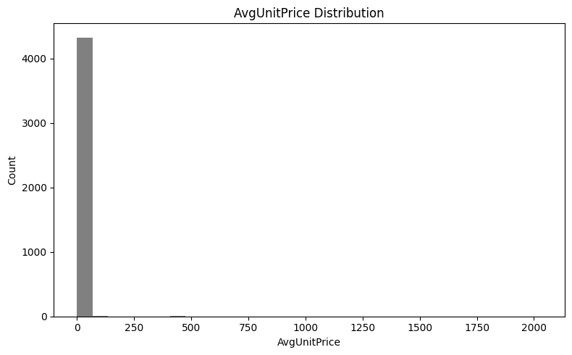
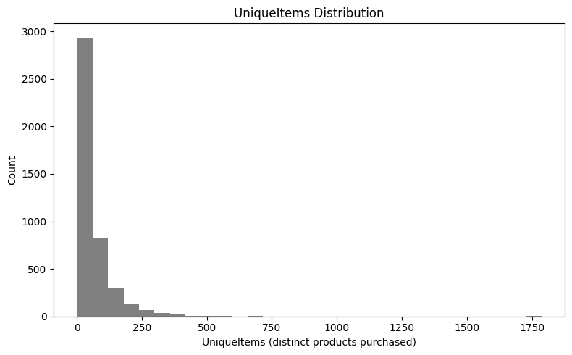
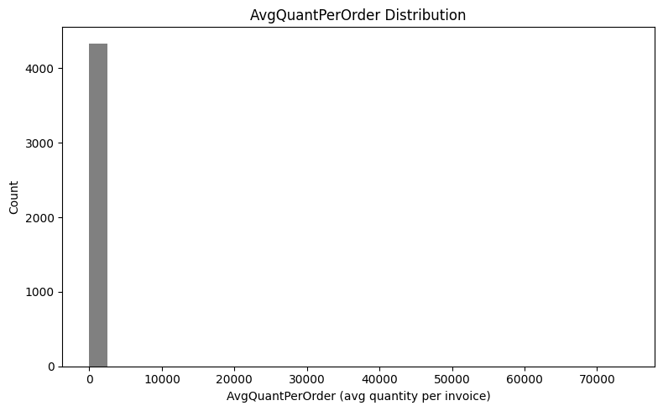
Intro
Data Cleaning
Standardization & PCA
Unsupervised Learning Method
Supervised
Learning Method
Conclusion
Visualization
Recency
Frequency
Monetary
AvgUnitPrice
UniqueItems
AvgQuantPerOrder

Slide 6
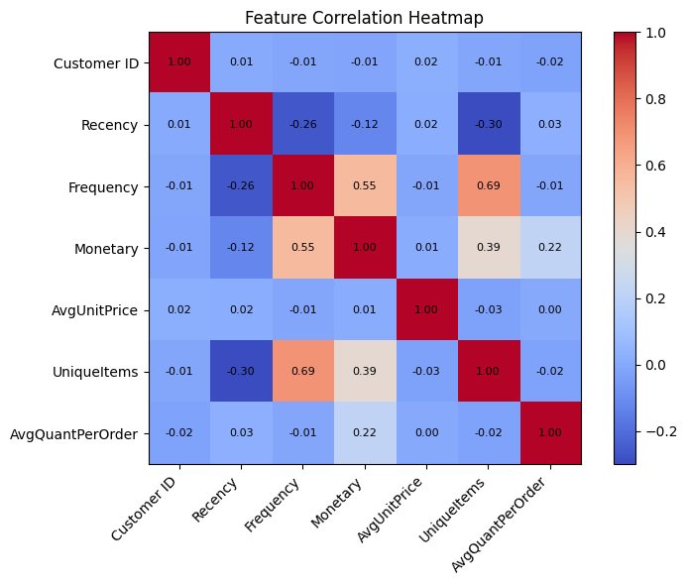
Intro
Data Cleaning
Standardization & PCA
Unsupervised Learning Method
Supervised
Learning Method
Conclusion

Slide 7
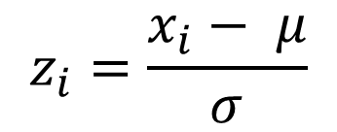
Intro
Data Cleaning
Standardization & PCA
Unsupervised Learning Method
Supervised
Learning Method
Conclusion
Standardization
$$z_{i}=\frac{x_{i}− μ}{σ}$$

Slide 8
Intro
Data Cleaning
Standardization & PCA
Unsupervised Learning Method
Supervised
Learning Method
Conclusion
PCA
 | Recency _scaled | Frequency _scaled | Monetary _scaled | AvgUnitPrice _scaled | UniqueItems _scaled | AvgQuantPerOrder _scaled | Explained_Var ratio
PC1 | -0.308 | 0.595 | 0.484 | -0.017 | 0.559 | 0.066 | 0.37
PC2 | 0.362 | -0.052 | 0.379 | 0.154 | -0.165 | 0.820 | 0.19
PC3 | -0.009 | 0.033 | -0.005 | 0.984 | 0.014 | -0.173 | 0.17
PC4 | 0.851 | 0.222 | 0.192 | -0.073 | 0.113 | -0.414 | 0.14
PC5 | -0.223 | -0.110 | 0.701 | -0.047 | -0.574 | -0.339 | 0.09
PC6 | -0.015 | 0.762 | -0.307 | -0.005 | -0.563 | 0.084 | 0.04
73%
PC1 (37.3%): Customer Value and Activity
PC2 (18.6%): Bulk or Wholesale Purchasing Behavior
PC3 (16.6%): Unit Price Preference

Slide 9
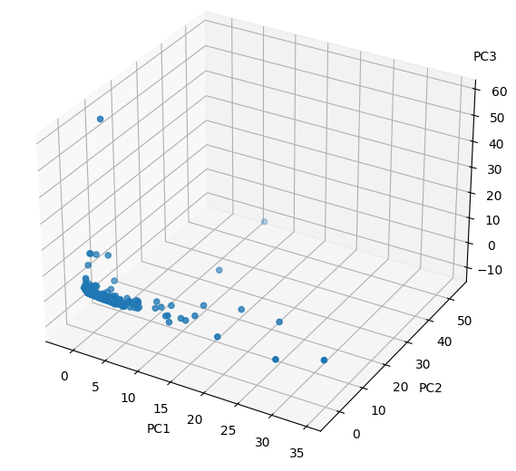
Intro
Data Cleaning
Standardization & PCA
Unsupervised Learning Method
Supervised
Learning Method
Conclusion
PC1 : Customer Value and Activity
PC2 : Bulk or Wholesale Purchasing Behavior
PC3 : Unit Price Preference

Slide 10

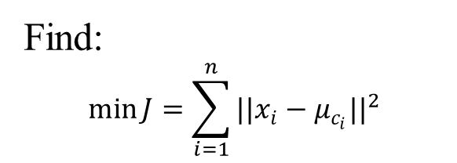
Intro
Data Cleaning
Standardization & PCA
Unsupervised Learning Method
Supervised
Learning Method
Conclusion
K-means Clustering
Find:
$$\min{J}=\sum_{i=1}^{n}{{||x_{i}−μ_{c_{i}}||}^{2}}$$
Repeat two simple steps:
Step 1 (Assign points)
$$c_{i}=\begin{matrix}argmin \\ j∈\{1,…,k\}\end{matrix}{||x_{i}−u_{j}||}^{2}$$
Step 2 (Update centers)
$$μ_{k}=\frac{1}{|C_{k}|}\sum_{x_{i}∈C_{k}}{x_{i}} , C_{k}=\left\{x_{i}:c_{i}=k\right\}$$
Until:
$$μ_{k}^{(t+1)}=μ_{k}^{(t)} ∀ k or J^{(t+1)}−J^{(t)}<ε$$

Slide 11
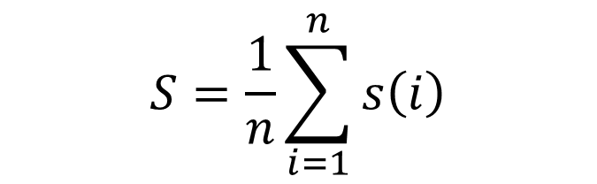

Intro
Data Cleaning
Standardization & PCA
Unsupervised Learning Method
Supervised
Learning Method
Conclusion
Silhouette Score
$$S=\frac{1}{n}\sum_{i=1}^{n}{s\left(i\right)}$$
$$s\left(i\right)=\frac{b\left(i\right)−a\left(i\right)}{\max\left\{a\left(i\right),b\left(i\right)\right\}}$$
$a\left(i\right)$: the average distance from point $i$ to other points in the same cluster.
$b\left(i\right)$: the average distance from point $i$ to the closest different cluster.

Slide 12
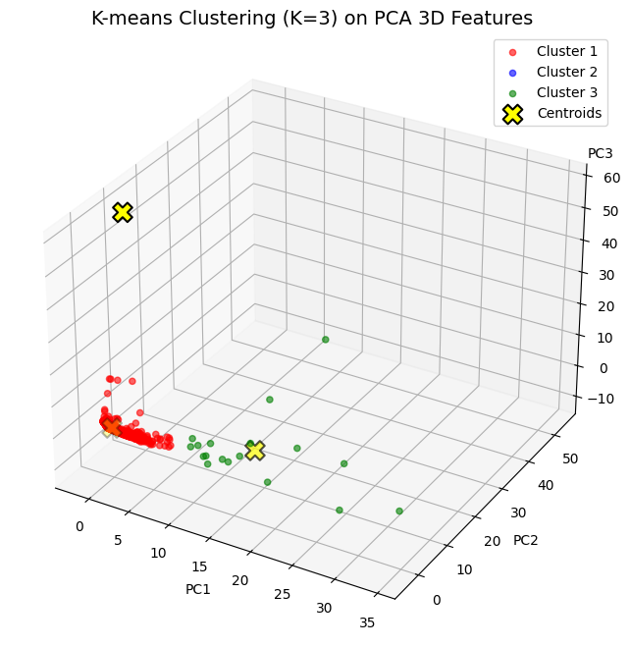
Intro
Data Cleaning
Standardization & PCA
Unsupervised Learning Method
Supervised
Learning Method
Conclusion
K-means after PCA
k | 2 | 3 | 4 | 5 | 6 | 7 | 8 | 9 | 10
score | 0.932 | 0.924 | 0.925 | 0.563 | 0.510 | 0.514 | 0.518 | 0.520 | 0.520
Cluster ID | 1 | 2 | 3
Quantity | 4320 | 1 | 18

Slide 13
Intro
Data Cleaning
Standardization & PCA
Unsupervised Learning Method
Supervised
Learning Method
Conclusion
K-means without PCA
k | 2 | 3 | 4 | 5 | 6 | 7 | 8 | 9 | 10
score | 0.446 | 0.470 | 0.466 | 0.466 | 0.466 | 0.510 | 0.470 | 0.502 | 0.399
Cluster ID | 1 | 2 | 3
Quantity | 3180 | 1140 | 18

Slide 14
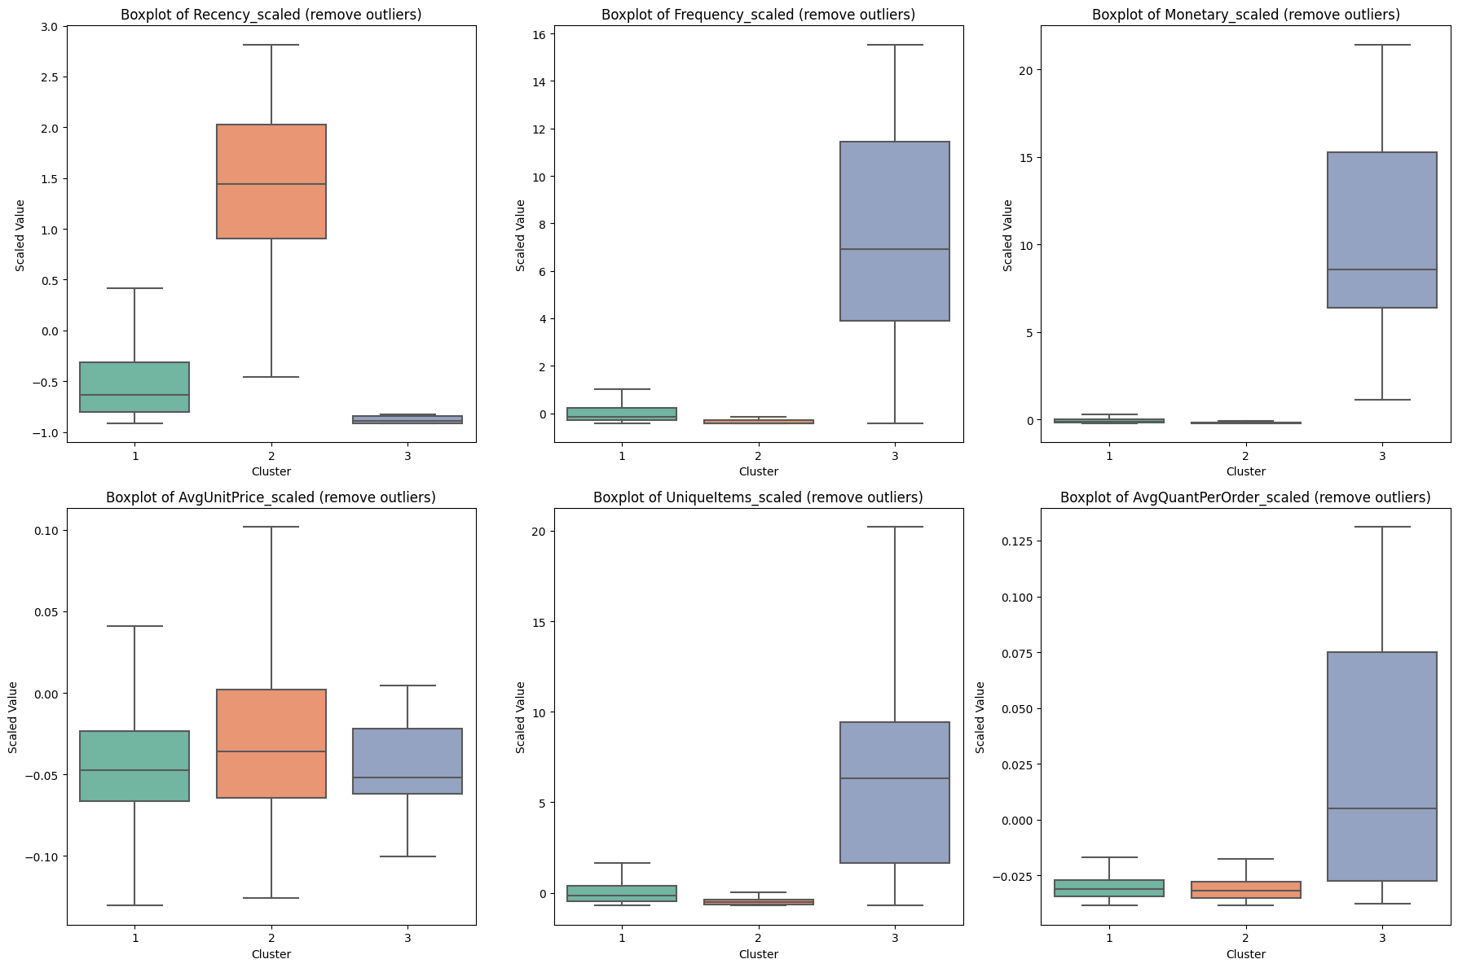
Intro
Data Cleaning
Standardization & PCA
Unsupervised Learning Method
Supervised
Learning Method
Conclusion
Recency
Frequency
Monetary
Unit Price
Unique Items
Quantity

Slide 15
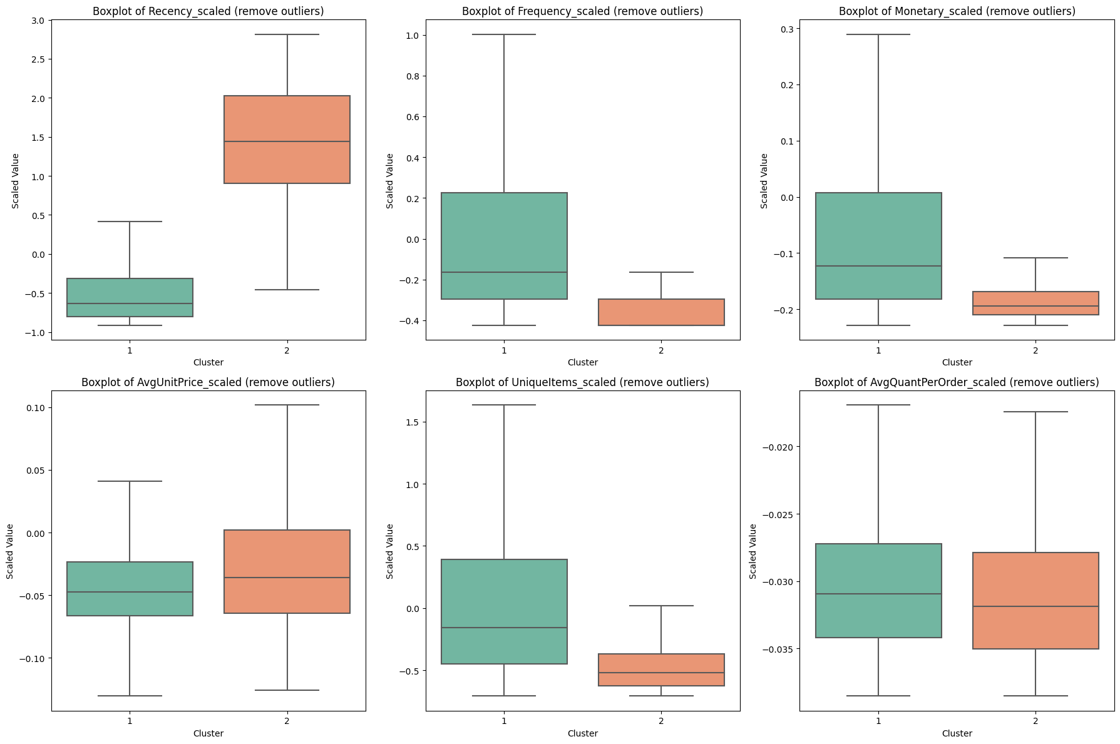
Intro
Data Cleaning
Standardization & PCA
Unsupervised Learning Method
Supervised
Learning Method
Conclusion
Recency
Frequency
Monetary
Unit Price
Unique Items
Quantity

Slide 16
Intro
Data Cleaning
Standardization & PCA
Unsupervised Learning Method
Supervised
Learning Method
Conclusion
Label
C1: Regular shoppers
C2: Inactive low-value shoppers
C3: High-value bulk buyers
Clustering Quality
k=3
Silhouette score = 0.470
Sizes (3181, 1140, 18)
The boxplots show clear differences across three groups

Slide 17
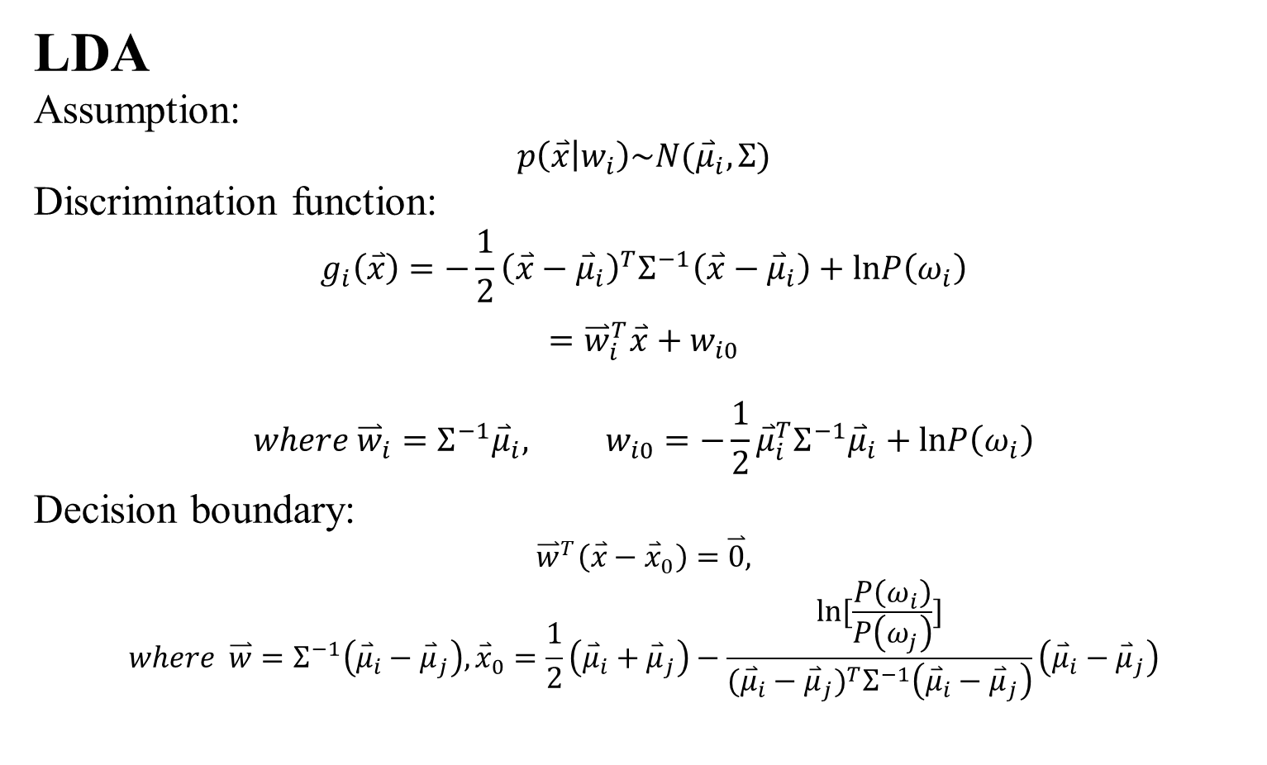
Intro
Data Cleaning
Standardization & PCA
Unsupervised Learning Method
Supervised
Learning Method
Conclusion
LDA
Assumption:
$$p\left(\overset{⃑}{x} | w_{i}\right)\sim N({\overset{⃑}{μ}}_{i}, Σ)$$
Discrimination function:
$$g_{i}\left(\overset{⃑}{x}\right)=−\frac{1}{2}{\left(\overset{⃑}{x}−{\overset{⃑}{μ}}_{i}\right)}^{T}Σ^{−1}\left(\overset{⃑}{x}−{\overset{⃑}{μ}}_{i}\right)+lnP\left(ω_{i}\right)$$
$$={\overset{⃑}{w}}_{i}^{T}\overset{⃑}{x}+w_{i0} \\ where {\overset{⃑}{w}}_{i}=Σ^{−1}{\overset{⃑}{μ}}_{i}, w_{i0}=−\frac{1}{2}{\overset{⃑}{μ}}_{i}^{T}Σ^{−1}{\overset{⃑}{μ}}_{i}+lnP\left(ω_{i}\right)$$
Decision boundary:
$${\overset{⃑}{w}}^{T}\left(\overset{⃑}{x}−{\overset{⃑}{x}}_{0}\right)=\overset{⃑}{0},$$
$$where \overset{⃑}{w}=Σ^{−1}\left({\overset{⃑}{μ}}_{i}−{\overset{⃑}{μ}}_{j}\right), {\overset{⃑}{x}}_{0}=\frac{1}{2}\left({\overset{⃑}{μ}}_{i}+{\overset{⃑}{μ}}_{j}\right)−\frac{ln[\frac{P\left(ω_{i}\right)}{P\left(ω_{j}\right)}]}{{({\overset{⃑}{μ}}_{i}−{\overset{⃑}{μ}}_{j})}^{T}Σ^{−1}\left({\overset{⃑}{μ}}_{i}−{\overset{⃑}{μ}}_{j}\right)}\left({\overset{⃑}{μ}}_{i}−{\overset{⃑}{μ}}_{j}\right)$$

Slide 18
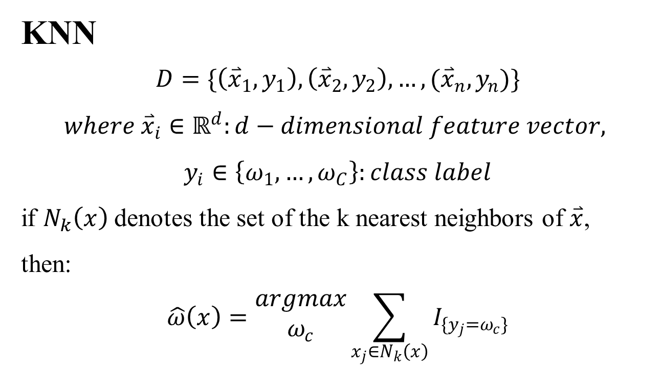
Intro
Data Cleaning
Standardization & PCA
Unsupervised Learning Method
Supervised
Learning Method
Conclusion
KNN
$$D=\{\left({\overset{⃑}{x}}_{1},y_{1}\right),\left({\overset{⃑}{x}}_{2},y_{2}\right),…,({\overset{⃑}{x}}_{n},y_{n})\}$$
$$where {\overset{⃑}{x}}_{i}∈ℝ^{d}:d−dimensional feature vector,$$
$$y_{i}∈\left\{ω_{1},…,ω_{C}\right\}:class label$$
if $N_{k}\left(x\right)$ denotes the set of the k nearest neighbors of $\overset{⃑}{x}$,
then:
$$\hat{ω}\left(x\right)=\begin{matrix}argmax \\ ω_{c}\end{matrix}\sum_{x_{j}∈N_{k}\left(x\right)}{I_{\{y_{j}=ω_{c}\}}}$$

Slide 19
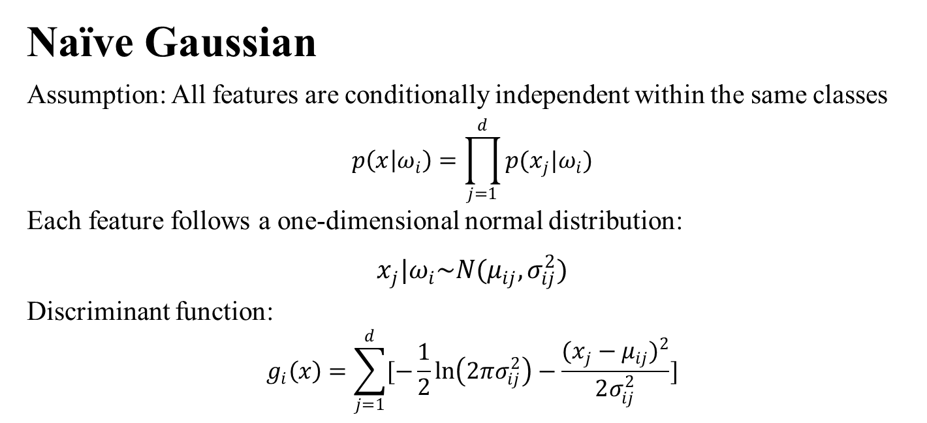
Intro
Data Cleaning
Standardization & PCA
Unsupervised Learning Method
Supervised
Learning Method
Conclusion
Naïve Gaussian
Assumption: All features are conditionally independent within the same classes
$$p\left(x | ω_{i}\right)=\prod_{j=1}^{d}{p(x_{j}|ω_{i})}$$
Each feature follows a one-dimensional normal distribution:
$$x_{j}|ω_{i}\sim N(μ_{ij},σ_{ij}^{2})$$
Discriminant function:
$$g_{i}\left(x\right)=\sum_{j=1}^{d}{[−\frac{1}{2}\ln\left(2πσ_{ij}^{2}\right)−\frac{{(x_{j}−μ_{ij})}^{2}}{2σ_{ij}^{2}}]}$$

Slide 20
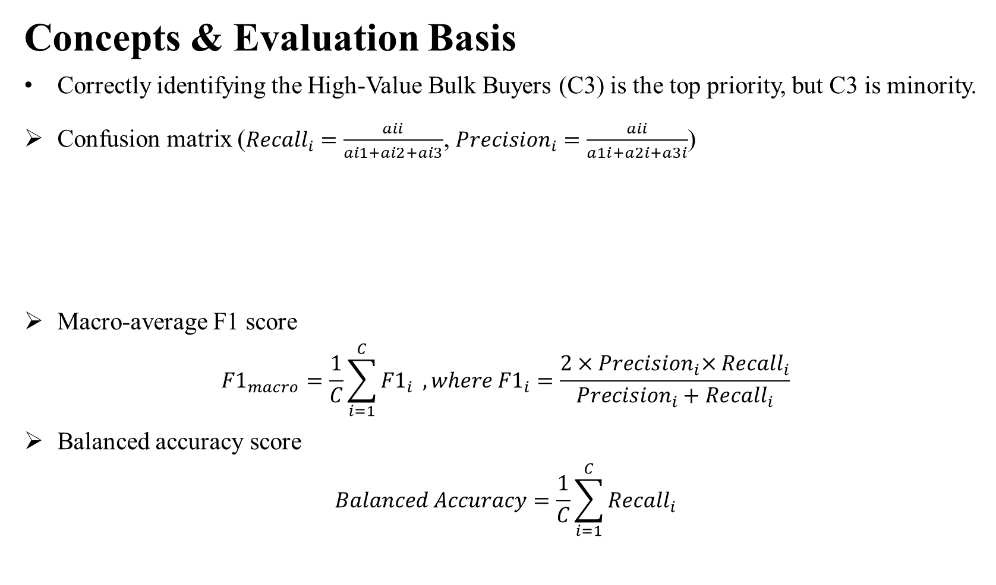
Intro
Data Cleaning
Standardization & PCA
Unsupervised Learning Method
Supervised
Learning Method
Conclusion
Concepts & Evaluation Basis
Correctly identifying the High-Value Bulk Buyers (C3) is the top priority, but C3 is minority.
Confusion matrix (${Recall}_{i}=\frac{aii}{ai1+ai2+ai3}$, ${Precision}_{i}=\frac{aii}{a1i+a2i+a3i}$)
Macro-average F1 score
$${F1}_{macro}=\frac{1}{C}\sum_{i=1}^{C}{{F1}_{i}} , where {F1}_{i}=\frac{2{×Precision}_{i}×{Recall}_{i}}{{Precision}_{i}+{Recall}_{i}}$$
Balanced accuracy score
$$Balanced Accuracy=\frac{1}{C}\sum_{i=1}^{C}{{Recall}_{i}}$$
Actual \ Pred | Pred C1 | Pred C2 | Pred C3
Actual C1 | a11 | a12 | a13
Actual C2 | a21 | a22 | a23
Actual C3 | a31 | a32 | a33

Slide 21
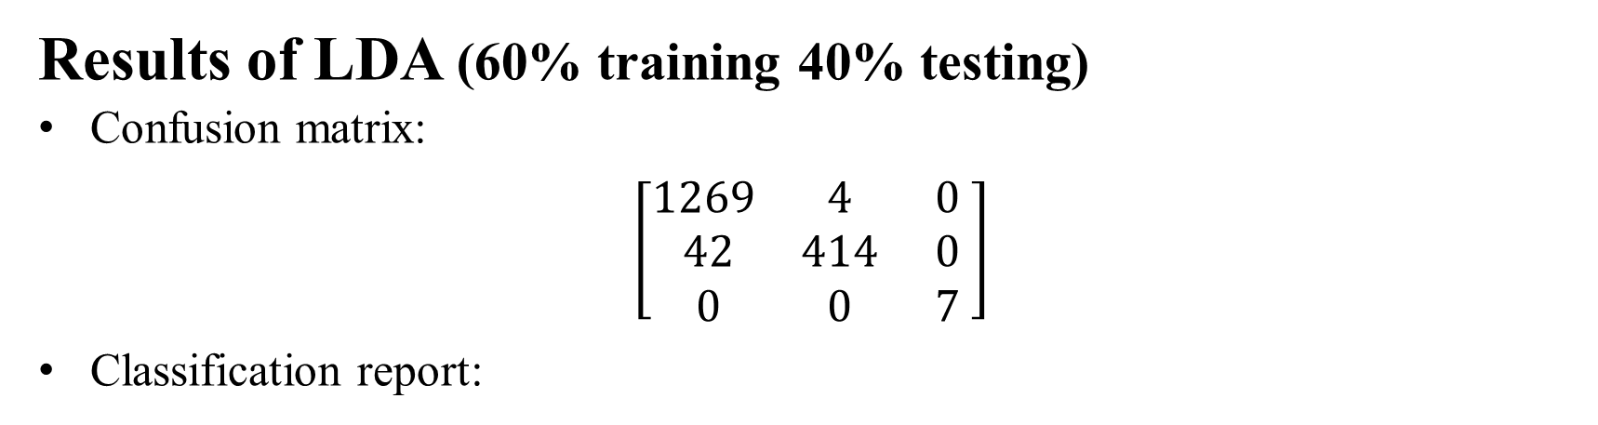
Intro
Data Cleaning
Standardization & PCA
Unsupervised Learning Method
Supervised
Learning Method
Conclusion
Results of LDA (60% training 40% testing)
Confusion matrix:
$$\left[\begin{matrix}\begin{matrix}1269 \\ 42 \\ 0\end{matrix} & \begin{matrix}4 \\ 414 \\ 0\end{matrix} & \begin{matrix} 0 \\ 0 \\ 7\end{matrix}\end{matrix}\right]$$
Classification report:
 | precision | recall | F1-score | support
C1 | 0.97 | 1.00 | 0.98 | 1273
C2 | 0.99 | 0.91 | 0.95 | 456
C3 | 1.00 | 1.00 | 1.00 | 7
Acc. |  |  |  | 0.97
Macro Avg. F1. |  |  |  | 0.98
Balanced Acc. |  |  |  | 0.97

Slide 22
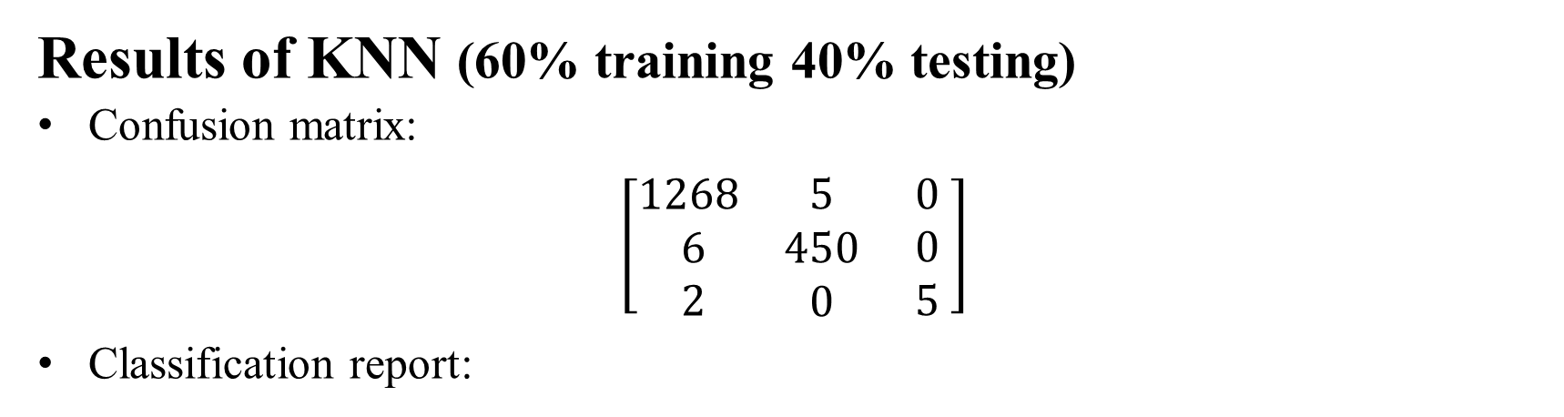
Intro
Data Cleaning
Standardization & PCA
Unsupervised Learning Method
Supervised
Learning Method
Conclusion
Results of KNN (60% training 40% testing)
Confusion matrix:
$$\left[\begin{matrix}\begin{matrix}1268 \\ 6 \\ 2\end{matrix} & \begin{matrix}5 \\ 450 \\ 0\end{matrix} & \begin{matrix} 0 \\ 0 \\ 5\end{matrix}\end{matrix}\right]$$
Classification report:
 | precision | recall | F1-score | support
C1 | 0.99 | 1.00 | 0.99 | 1273
C2 | 0.99 | 0.91 | 0.99 | 456
C3 | 1.00 | 0.71 | 0.83 | 7
Acc. |  |  |  | 0.99
Macro Avg. F1. |  |  |  | 0.94
Balanced Acc. |  |  |  | 0.90

Slide 23
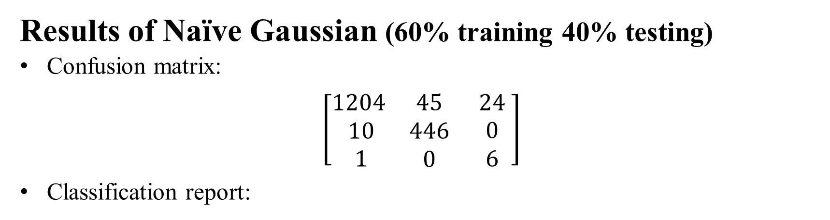
Intro
Data Cleaning
Standardization & PCA
Unsupervised Learning Method
Supervised
Learning Method
Conclusion
Results of Naïve Gaussian (60% training 40% testing)
Confusion matrix:
$$\left[\begin{matrix}\begin{matrix}1204 \\ 10 \\ 1\end{matrix} & \begin{matrix}45 \\ 446 \\ 0\end{matrix} & \begin{matrix} 24 \\ 0 \\ 6\end{matrix}\end{matrix}\right]$$
Classification report:
 | precision | recall | F1-score | support
C1 | 0.99 | 0.95 | 0.97 | 1273
C2 | 0.91 | 0.98 | 0.94 | 456
C3 | 0.2 | 0.86 | 0.32 | 7
Acc. |  |  |  | 0.95
Macro Avg. F1. |  |  |  | 0.74
Balanced Acc. |  |  |  | 0.93

Slide 24
Intro
Data Cleaning
Standardization & PCA
Unsupervised Learning Method
Supervised
Learning Method
Conclusion
Discussion: (LDA > KNN > Naïve Gaussian)
1. LDA
The three clusters exhibit strong directional differences that make them close to linearly separable.
2. KNN
Can easily be misclassified if a data close to another class in certain dimensions
3. Naïve Gaussian
sensitive to dimensions where samples appear close to other classes.
the assumption that all features are independent within a class is unrealistic

Slide 25
Intro
Data Cleaning
Standardization & PCA
Unsupervised Learning Method
Supervised
Learning Method
Conclusion
Conclusion:
This case shows that when the dataset is:
The number of features is limited
Customer behaviors exhibit clear directional differences
Simple and interpretable linear models (such as LDA) can accurately identify high-value customers, without necessarily relying on complex models.

